Slide 1
P02
Transport to RP
6th Presentation
A113 – Mathematics

Slide 2
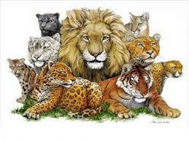
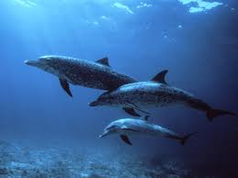
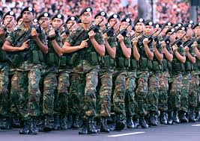
Set Notation
We often come across different collection of objects in our daily life. For instance,
A family of cats
A troop of soldiers
A pod of dolphins.

Slide 3
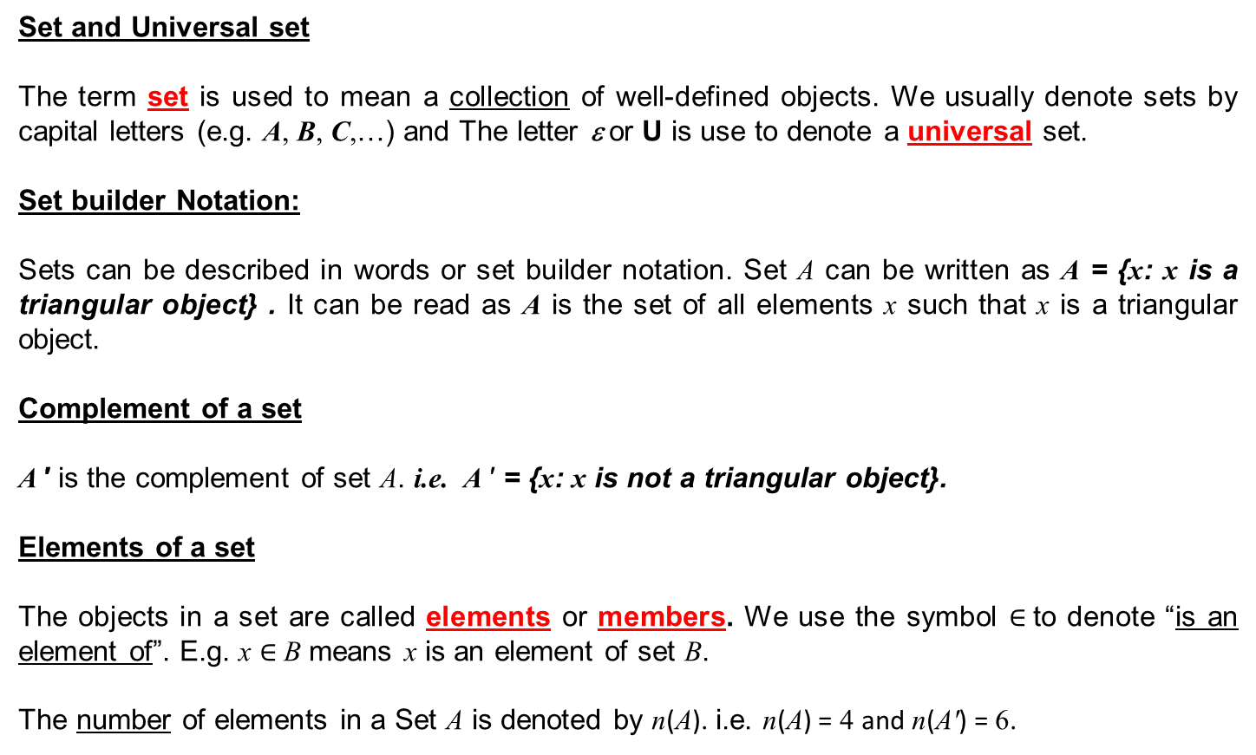
Definitions
Set and Universal set
The term set is used to mean a collection of well-defined objects. We usually denote sets by capital letters (e.g. A, B, C,…) and The letter ε or U is use to denote a universal set.
Set builder Notation:
Sets can be described in words or set builder notation. Set A can be written as A = {x: x is a triangular object} . It can be read as A is the set of all elements x such that x is a triangular object.
Complement of a set
A ′ is the complement of set A. i.e. A ′ = {x: x is not a triangular object}.
Elements of a set
The objects in a set are called elements or members. We use the symbol $∈$to denote “is an element of”. E.g. x $∈$B means x is an element of set B.
The number of elements in a Set A is denoted by n(A). i.e. n(A) = 4 and n(A′) = 6.

Slide 4
Definitions
Equal Sets
If sets X and Y have the exact same elements in them, they are equal sets, that is, X = Y . Otherwise, X ≠ Y.
Subsets
If every element of a set X is also an element of a set Y, then X is said to be a subset of Y, that is, X ⊆ Y
If X is not a subset of Y , then this is denoted as X ⊈ Y
Proper Subset
If X ⊆ Y but X ≠ Y, then X is said to be a proper subset of Y , that is, X ⊂ Y.
If X is not a proper subset of Y , then this is denoted as X ⊄ Y.

Slide 5
Definitions
Intersection of sets
The intersection of two sets, X and Y, denoted by X ∩ Y, is the set of all elements that belong to both X and Y.
X ∩ Y = {x : x ∈ X and x ∈ Y}
It can be represented by the Venn diagram below: The shaded region represents X ∩ Y.
ε
X
Y

Slide 6
Definitions
Union of sets
The union of two sets, X and Y, denoted by X ∪ Y, is the set of all elements that belong to X or Y or both.
X ∪ Y = {x : x ∈ X or x ∈ Y}
It can be represented by the Venn diagram below: The shaded region represents X ∪ Y.
ε
X
Y

Slide 7
Definitions
Disjoint sets and Empty set
When two distinct sets do not have any common element, they are known as disjoint sets. It can be represented by the Venn diagram below
When a set has no elements, it is called an empty set. An empty set is denoted by φ (read as phi) or { }. The empty set φ is a subset of every set.
In this case, X ∩ Y = { } = φ
ε
X
Y

Slide 8
Summary of Set Notation
  Complement of set A, A’
  Universal set U , ε
  An element or not, ∈, ∉
  Equal sets or not equal sets, =, ≠
  Subset and not subset, A ⊆ B ,A ⊈ B
  Proper Subset and not proper subset, A ⊂ B, A ⊄ B
  Number of elements in Set A, n(A)
  Union of two sets A ∪ B
  Intersection of two sets A ∩ B
  Empty Set ∅, {}

Slide 9
Venn Diagrams
We can represent the relationships between different sets in a Venn diagram.
A rectangle is used to represent the universal set ε.
Usually closed curves such as circles or ovals drawn inside the rectangle are used to represent subsets of ε.
In the above Venn diagram, A and B are subsets of ε. Circle A is drawn inside of circle B → A is a proper subset of B. [i.e. A ⊂ B, A ⊂ ε and B ⊂ ε]
ε
B
A

Slide 10
Venn Diagrams
ε
A
A’
A and A’
ε
ε
A
A
B
B
A ∪ B
A ∩ B

Slide 11
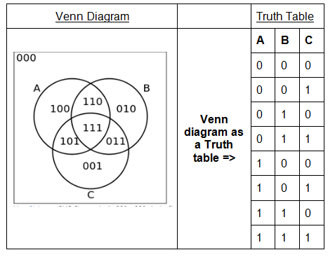
Venn Diagram and Truth Table
The different regions in the Venn diagram can be represented in the Truth Table. The truth value is either true (T) or false (F). ‘1’ and ‘0’ are also used to indicate T and F respectively.

Slide 12
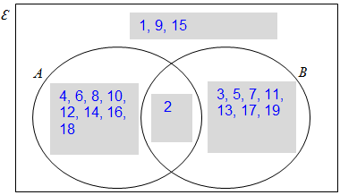
Worked Example (Practice Questions Q4)
Let ε = {x : x is a positive integer and 1 ≤ x < 20 }
A = {x : x is a even number}
B = {x : x is prime number}
Represent the sets using a Venn diagram.
A = {2, 4, 6, 8, 10, 12, 14, 16, 18}
B = {2, 3, 5, 7, 11, 13, 17, 19}
→ There is a common element, 2. Hence Sets A and B intersect.

Slide 13
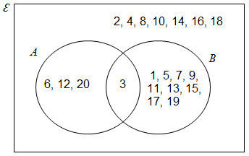
Worked Example (Practice Questions Q6a)
Refer to the following Venn diagram.
List all the elements in the sets A, B’, A’ ∪ B’ and A’ ∩ B’.
Describe sets ε and B using set builder notation.
Find n(A’ ∪ B)
(a) A = {3, 6, 12, 20}
B’ = {2, 4, 6, 8, 10, 12, 14, 16, 18, 20}
A’ ∪ B’ = {1, 2, 4, 5, 6, 7, 8, 9, 10, 11, 12, 13, 14, 15, 16, 17, 18, 19, 20}
A’ ∩ B’ = {2, 4, 8, 10, 14, 16, 18}

Slide 14
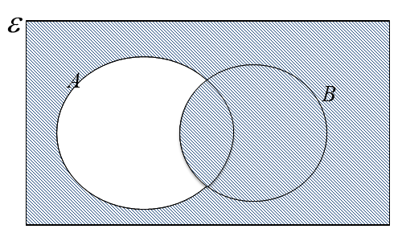
Worked Example (Practice Questions Q6b & c)
(b) Describe sets ε and B using set builder notation.
ε = {x : x is a positive integer and 1 ≤ x ≤ 20}
B = {x : x is a positive odd integer}
(c) Find n(A’ ∪ B)
A’ ∪ B is represented by
Hence, n(A’ ∪ B) = 20 – 3 = 17

Slide 15
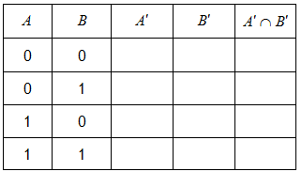
Worked Example (Practice Questions Q7)
The following show the incomplete truth tables for A′ ∩ B′ and A′ ∪ B′. Complete the tables by working out the truth values, indicating your answer using “T”, “F”, “1” and “0”.
(“T” is true , “F” is false, “1” is true, “0” is false)
Complement of 0 is 1
1
1
1
1
0
0
0
1
0
Complement of 1 is 0
0
0
0
We may view ∩ as a “multiplication”. In this case, we have the following:
Row 1: A′ ∩ B′ can be interpreted as 1 × 1 = 1
Row 2: A′ ∩ B′ can be interpreted as 1 × 0 = 0
Row 3: A′ ∩ B′ can be interpreted as 0 × 1 = 0
Row 4: A′ ∩ B′ can be interpreted as 0 × 0 = 0

Slide 16
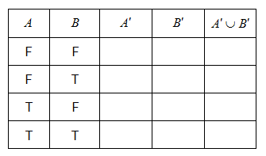
Worked Example (Practice Questions Q7)
The following show the incomplete truth tables for A′ ∩ B′ and A′ ∪ B′. Complete the tables by working out the truth values, indicating your answer using “T”, “F”, “1” and “0”.
(“T” is true , “F” is false, “1” is true, “0” is false)
Complement of F is T
T
1
T
1
T
1
T
1
F
0
T
1
F
T
1
T
1
0
Complement of T is F
F
0
F
0
F
0
Assign a value of 1 to T and a value of 0 to F.
We may view ∪ as an “addition”. In this case, we have the following:
Row 1: A′ ∪ B′ can be interpreted as 1 + 1 = 1 (capped at 1)
Row 2: A′ ∪ B′ can be interpreted as 1 + 0 = 1
Row 3: A′ ∪ B′ can be interpreted as 0 + 1 = 1
Row 4: A′ ∪ B′ can be interpreted as 0 + 0 = 0

Slide 17
Worked Example (Practice Questions Q8)
A survey on ice-cream flavor preference was conducted. Out of the 100 students surveyed, 12 prefer Mango and Banana flavor, 40 prefer Mango flavor, 27 prefer Banana flavor, 10 prefer Coconut flavor, the rest prefer other flavors. Those who prefer Coconut do not prefer other flavors.
Set B = {students who prefer Banana flavor},
Set M = {students who prefer Mango flavor}.
Set C = {students who prefer Coconut flavor}.
Represent the above using a Venn diagram. Indicate the number of students in each region.
Construct a truth table for all possible scenarios.
Express in set notation, students who prefer other flavors.

Slide 18
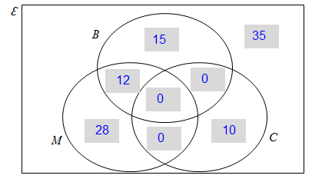
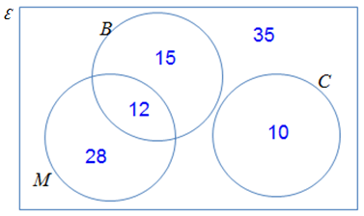
Worked Example (Practice Questions Q8a)
Represent the above using a Venn diagram. Indicate the number of
students in each region.
OR

Slide 19
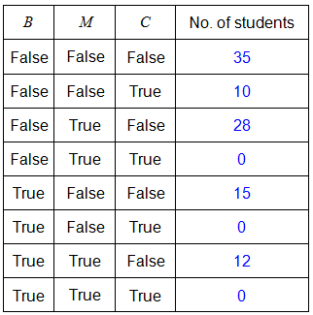
Worked Example (Practice Questions Q8b,c)
Construct a truth table for all possible scenarios.
c) Express in set notation, students who prefer other flavors.
(B ∪ C ∪ M)’ or (B’ ∩ C’ ∩ M’)

Slide 20
Scenario (Solution)
Truth Table
Descriptions | MRT | Taxi | Bus | Set Notation | No. of Students
Students travelling by MRT only | True | False | False | M ∩ T’ ∩ B’ | 58
Students travelling by Taxi only | False | True | False | M’ ∩ T ∩ B’ | 41
Students travelling by Bus only | False | False | True | M’ ∩ T’ ∩ B | 35
Students travelling by MRT and Taxi only | True | True | False | M ∩ T ∩ B’ | 6
Students travelling by MRT and Bus only | True | False | True | M ∩ T’ ∩ B | 15
Students travelling by Taxi and Bus only | False | True | True | M’ ∩ T ∩ B | 18
Students travelling using all three modes of transport | True | True | True | M ∩ T ∩ B | 5
Students who do not travel by these three modes of transport | False | False | False | M’ ∩ T’ ∩ B’ | 3
 |  |  |  | Total: | 181
Note* : the sum of all the distinct groups of students gives you the total no. of students surveyed.

Slide 21
Scenario (Solution)
ε
M
3
58
B
6
15
T
5
35
41
18
58 students travelled by MRT only.
35 students travelled by Bus only.
41 students travelled by Taxi only.
44 students travelled using at least 2 modes of transport. (i.e. 6 + 15 + 18 + 5 = 44)
5 students travel using these three modes of transport.
3 students do not use these three modes of transport.

Slide 22
Learning objectives
Apply working knowledge of set notation under various scenarios.
Perform elementary set operations: complement, intersection and union.
Represent sets using Truth Table and Venn Diagrams.
Verify elementary results involving sets using Venn Diagrams.

Slide 23
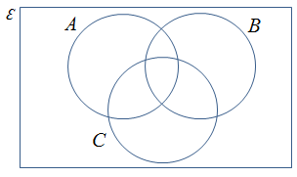
Exploring Further
Verify whether the following relationships are correct by shading the Venn Diagram.
a) (A ∪ B)’ = A’ ∩ B’
b) (A ∩ B)’ = A’ ∪ B’
c) A ∪ B) ∪ C = A ∪ (B ∪ C)
d) (A ∩ B) ∩ C = A ∩ (B ∩ C)
e) A ∪ (B ∩ C) = (A ∪ B) ∩ (A ∪ C )
f) A ∩ (B ∪ C) = (A ∩ B) ∪ (A ∩ C )

